Slide 1


Chapter 19
Java
Never Ends
Copyright © 2010 Pearson Addison-Wesley. All rights reserved.

Slide 2
Multithreading
In Java, programs can have multiple threads
  A thread is a separate computation process
Threads are often thought of as computations that run in parallel
  Although they usually do not really execute in parallel
  Instead, the computer switches resources between threads so that each one does a little bit of computing in turn
Modern operating systems allow more than one program to run at the same time
  An operating system uses threads to do this
Copyright © 2010 Pearson Addison-Wesley. All rights reserved.
19-<number>

Slide 3
Thread.sleep
Thread.sleep is a static method in the class Thread that pauses the thread that includes the invocation
  It pauses for the number of milliseconds given as an argument
  Note that it may be invoked in an ordinary program to insert a pause in the single thread of that program
It may throw a checked exception, InterruptedException, which must be caught or declared
  Both the Thread and InterruptedException classes are in the package java.lang
Copyright © 2010 Pearson Addison-Wesley. All rights reserved.
19-<number>

Slide 4
The getGraphics Method
The method getGraphics is an accessor method that returns the associated Graphics object of its calling object
  Every JComponent has an associated Graphics object
    Component.getGraphics();
Copyright © 2010 Pearson Addison-Wesley. All rights reserved.
19-<number>

Slide 5
A Nonresponsive GUI
The following program contains a simple GUI that draws circles one after the other when the "Start" button is clicked
  There is a 1/10 of a second pause between drawing each circle
If the close-window button is clicked, nothing happens until the program is finished drawing all its circles
Note the use of the Thread.sleep (in the method doNothing) and getGraphics (in the method fill) methods
Copyright © 2010 Pearson Addison-Wesley. All rights reserved.
19-<number>

Slide 6
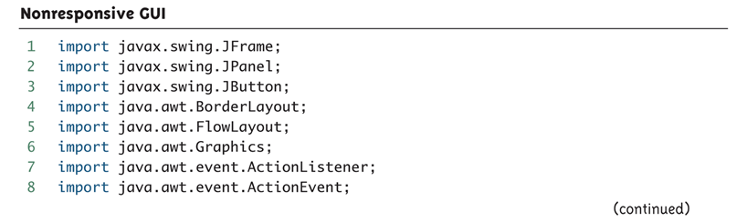
Nonresponsive GUI (Part 1 of 9)
Copyright © 2010 Pearson Addison-Wesley. All rights reserved.
19-<number>

Slide 7
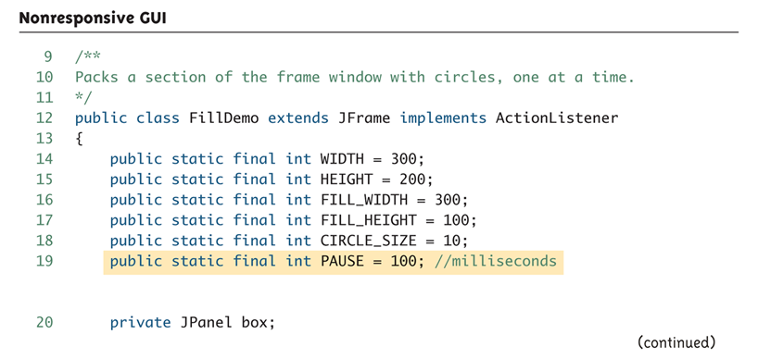
Nonresponsive GUI (Part 2 of 9)
Copyright © 2010 Pearson Addison-Wesley. All rights reserved.
19-<number>

Slide 8
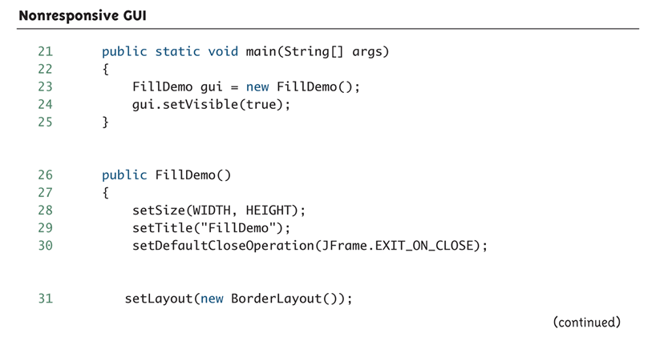
Nonresponsive GUI (Part 3 of 9)
Copyright © 2010 Pearson Addison-Wesley. All rights reserved.
19-<number>

Slide 9
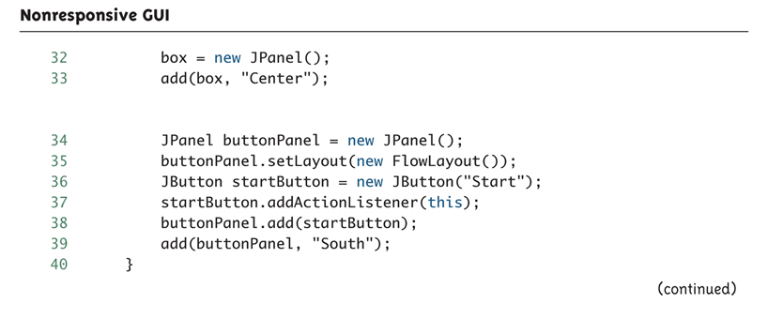
Nonresponsive GUI (Part 4 of 9)
Copyright © 2010 Pearson Addison-Wesley. All rights reserved.
19-<number>

Slide 10
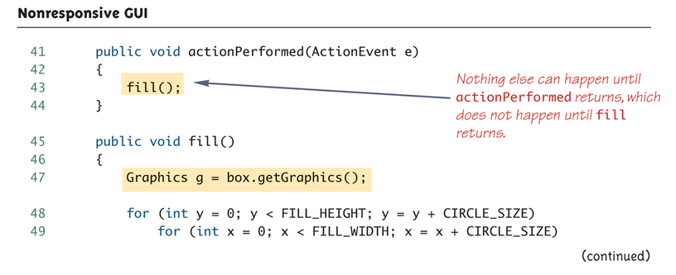
Nonresponsive GUI (Part 5 of 9)
Copyright © 2010 Pearson Addison-Wesley. All rights reserved.
19-<number>

Slide 11
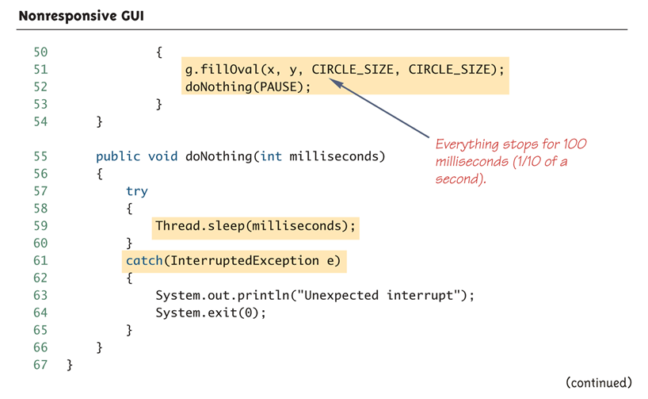
Nonresponsive GUI (Part 6 of 9)
Copyright © 2010 Pearson Addison-Wesley. All rights reserved.
19-<number>

Slide 12
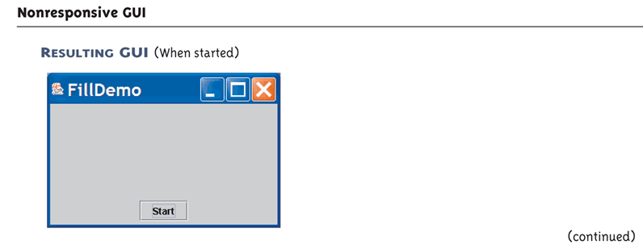
Nonresponsive GUI (Part 7 of 9)
Copyright © 2010 Pearson Addison-Wesley. All rights reserved.
19-<number>

Slide 13
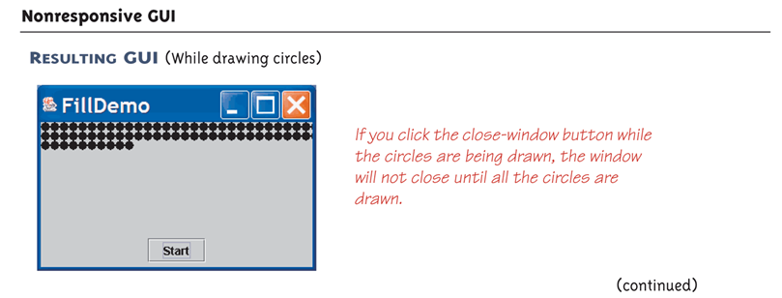
Nonresponsive GUI (Part 8 of 9)
Copyright © 2010 Pearson Addison-Wesley. All rights reserved.
19-<number>

Slide 14
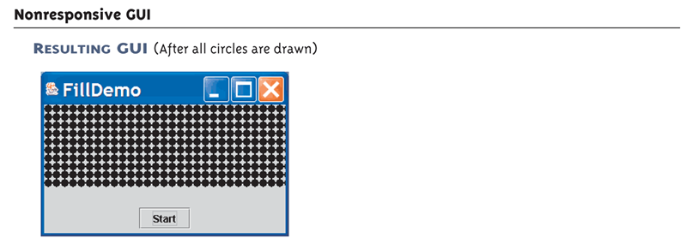
Nonresponsive GUI (Part 9 of 9)
Copyright © 2010 Pearson Addison-Wesley. All rights reserved.
19-<number>

Slide 15
Fixing a Nonresponsive Program Using Threads
This is why the close-window button does not respond immediately:
  Because the method fill is invoked in the body of the method actionPerformed, the method actionPerformed does not end until after the method fill ends
  Therefore, the method actionPerformed does not end until after the method fill ends
  Until the method actionPerformed ends, the GUI cannot respond to anything else
Copyright © 2010 Pearson Addison-Wesley. All rights reserved.
19-<number>

Slide 16
Fixing a Nonresponsive Program Using Threads
This is how to fix the problem:
  Have the actionPerformed method create a new (independent) thread to draw the circles
  Once created, the new thread will be an independent process that proceeds on its own
  Now, the work of the actionPerformed method is ended, and the main thread (containing actionPerformed) is ready to respond to something else
  If the close-window button is clicked while the new thread draws the circles, then the program will end
Copyright © 2010 Pearson Addison-Wesley. All rights reserved.
19-<number>

Slide 17
The Class Thread
In Java, a thread is an object of the class Thread
Usually, a derived class of Thread is used to program a thread
  The methods run and start are inherited from Thread
  The derived class overrides the method run to program the thread
  The method start initiates the thread processing and invokes the run method
Copyright © 2010 Pearson Addison-Wesley. All rights reserved.
19-<number>

Slide 18
A Multithreaded Program that Fixes a Nonresponsive GUI
The following program uses a main thread and a second thread to fix the nonresponsive GUI
  It creates an inner class Packer that is a derived class of Thread
  The method run is defined in the same way as the previous method fill
  Instead of invoking fill, the actionPerformed method now creates an instance of Packer, a new independent thread named packerThread
  The packerThread object then invokes its start method
  The start method initiates processing and invokes run
Copyright © 2010 Pearson Addison-Wesley. All rights reserved.
19-<number>

Slide 19
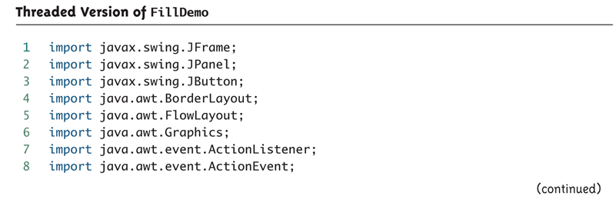
Threaded Version of FillDemo (Part 1 of 6)
The GUI produced is identical to the GUI produced by Display 19.1 except that in this version the close window button works even while the circles are being drawn, so you can end the GUI early if you get bored.
Copyright © 2010 Pearson Addison-Wesley. All rights reserved.
19-<number>

Slide 20
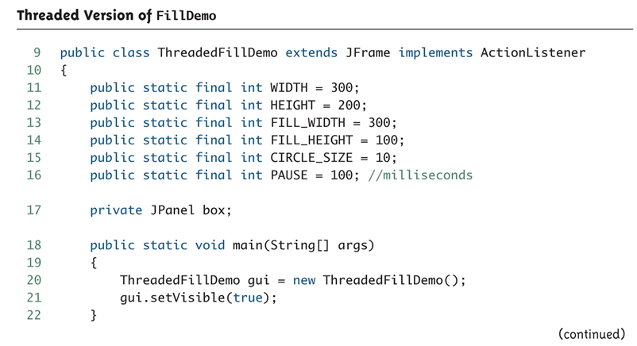
Threaded Version of FillDemo (Part 2 of 6)
Copyright © 2010 Pearson Addison-Wesley. All rights reserved.
19-<number>

Slide 21
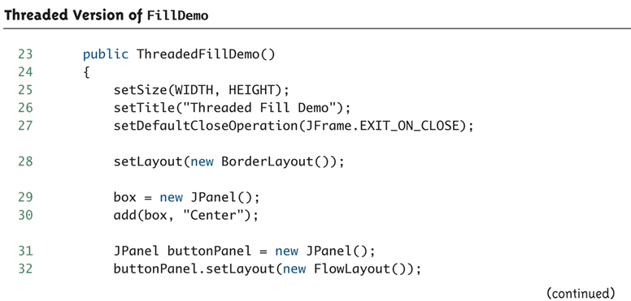
Threaded Version of FillDemo (Part 3 of 6)
Copyright © 2010 Pearson Addison-Wesley. All rights reserved.
19-<number>

Slide 22
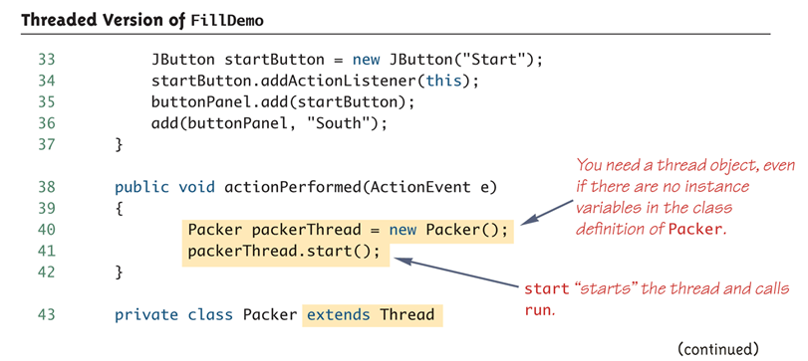
Threaded Version of FillDemo (Part 4 of 6)
Copyright © 2010 Pearson Addison-Wesley. All rights reserved.
19-<number>

Slide 23
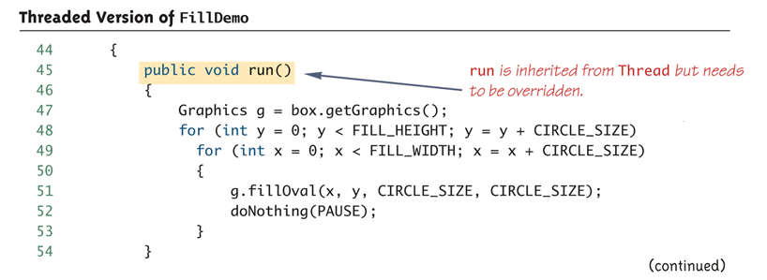
Threaded Version of FillDemo (Part 5 of 6)
Copyright © 2010 Pearson Addison-Wesley. All rights reserved.
19-<number>

Slide 24
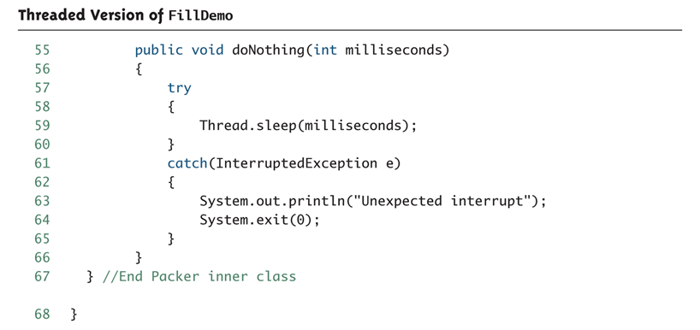
Threaded Version of FillDemo (Part 6 of 6)
Copyright © 2010 Pearson Addison-Wesley. All rights reserved.
19-<number>

Slide 25
The Runnable Interface
Another way to create a thread is to have a class implement the Runnable interface
  The Runnable interface has one method heading:
    public void run();
A class that implements Runnable must still be run from an instance of Thread
  This is usually done by passing the Runnable object as an argument to the thread constructor
Copyright © 2010 Pearson Addison-Wesley. All rights reserved.
19-<number>

Slide 26
The Runnable Interface: Suggested Implementation Outline
public class ClassToRun extends SomeClass implements Runnable
{ . . .
public void run()
{
// Fill this as if ClassToRun
// were derived from Thread
}
. . .
public void startThread()
{
Thread theThread = new Thread(this);
theThread.run();
}
. . .
}
Copyright © 2010 Pearson Addison-Wesley. All rights reserved.
19-<number>

Slide 27
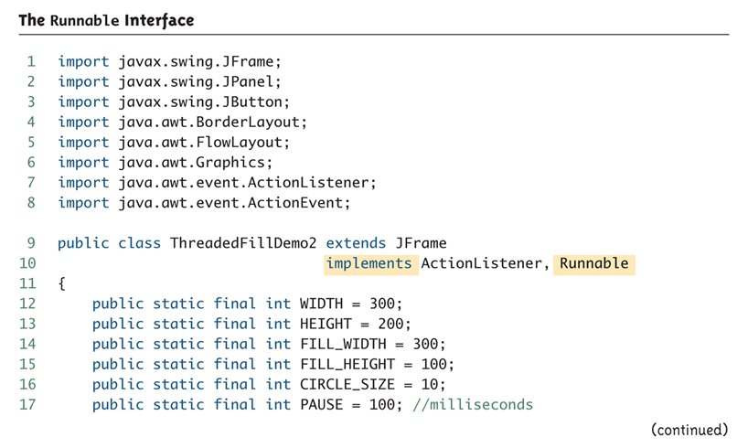
The Runnable Interface (Part 1 of 5)
Copyright © 2010 Pearson Addison-Wesley. All rights reserved.
19-<number>

Slide 28
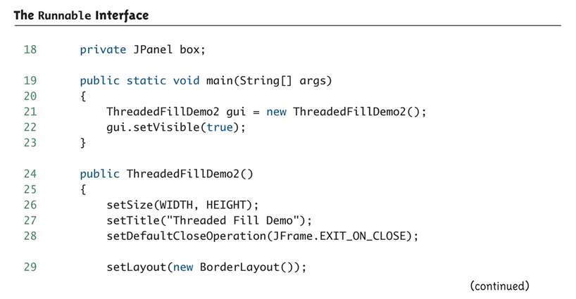
The Runnable Interface (Part 2 of 5)
Copyright © 2010 Pearson Addison-Wesley. All rights reserved.
19-<number>

Slide 29
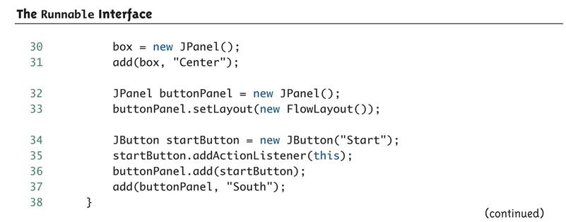
The Runnable Interface (Part 3 of 5)
Copyright © 2010 Pearson Addison-Wesley. All rights reserved.
19-<number>

Slide 30
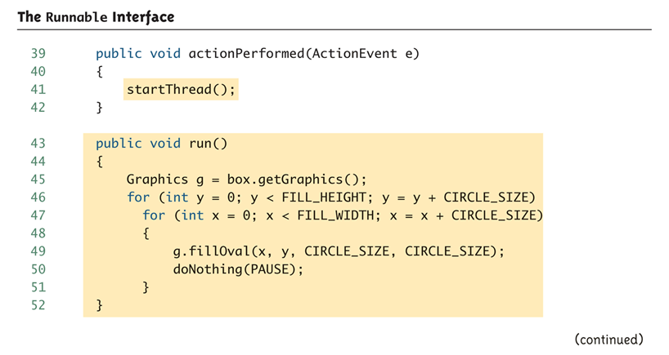
The Runnable Interface (Part 4 of 5)
Copyright © 2010 Pearson Addison-Wesley. All rights reserved.
19-<number>

Slide 31
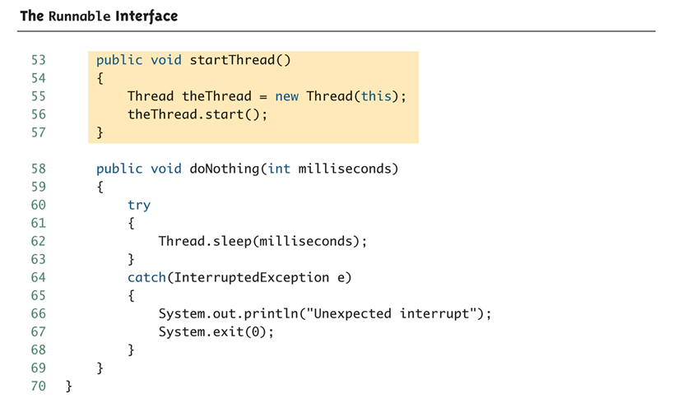
The Runnable Interface (Part 5 of 5)
Copyright © 2010 Pearson Addison-Wesley. All rights reserved.
19-<number>

Slide 32
Networking with Stream Sockets
Transmission Control Protocol – TCP
  Most common network protocol on the Internet
  Called a reliable protocol because it guarantees that data sent from the sender is received in the same order it is sent
Server
  Program waiting to receive input
Client
  Program that initiates a connection to the server
Copyright © 2010 Pearson Addison-Wesley. All rights reserved.
19-<number>

Slide 33
Sockets
A socket describes one end of the connection between two programs over the network. It consists of:
  An address that identifies the remote computer, e.g. IP Address
  A port for the local and remote computer
    Number between 0 and 65535
    Identifies the program that should handle data received by the network
    Only one program may bind to a port
    Ports 0 to 1024 are reserved for the operating system
Copyright © 2010 Pearson Addison-Wesley. All rights reserved.
19-<number>

Slide 34
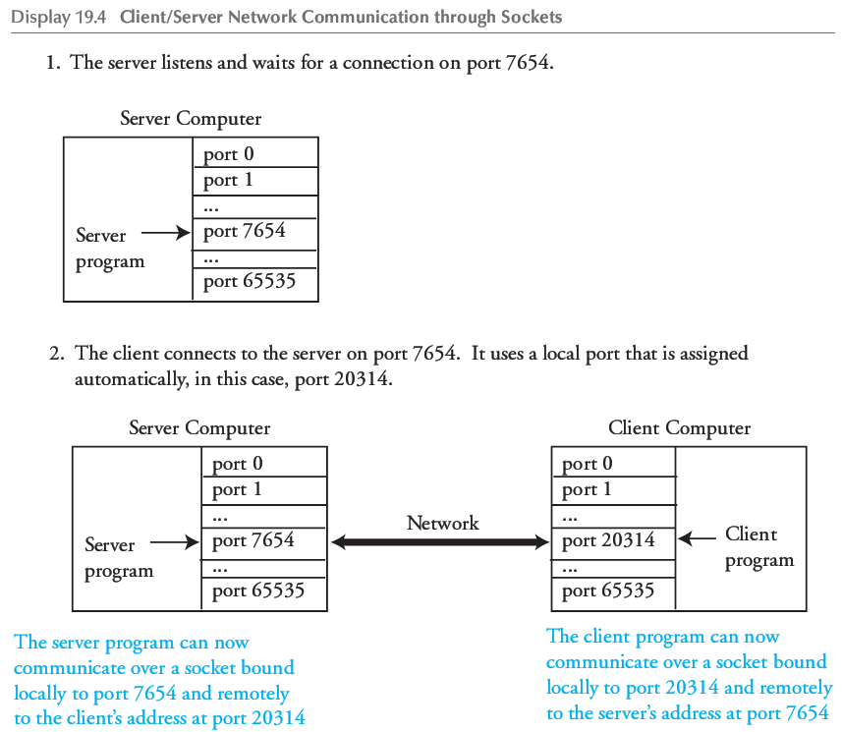
Client/Server Socket Example
Copyright © 2010 Pearson Addison-Wesley. All rights reserved.
19-<number>

Slide 35
Sockets Programming
Very similar to File I/O using a FileOutputStream but instead we substitute a DataOutputStream
We can use localhost as the name of the local machine
Socket and stream objects throw checked exceptions
  We must catch them
Copyright © 2010 Pearson Addison-Wesley. All rights reserved.
19-<number>

Slide 36
Date and Time Server (1 of 2)
1 import java.util.Date;
2 import java.net.ServerSocket;
3 import java.net.Socket;
4 import java.io.DataOutputStream;
5 import java.io.BufferedReader;
6 import java.io.InputStreamReader;
7 import java.io.IOException;
8 public class DateServer
9 {
10 public static void main(String[] args)
11 {
12 Date now = new Date( );
13 try
14 {
15 System.out.println("Waiting for a connection on port 7654.");
16 ServerSocket serverSock = new ServerSocket(7654);
17 Socket connectionSock = serverSock.accept( );
18 BufferedReader clientInput = new BufferedReader(
19 new InputStreamReader(connectionSock.getInputStream( )));
20 DataOutputStream clientOutput = new DataOutputStream(
21 connectionSock.getOutputStream( ));
Copyright © 2010 Pearson Addison-Wesley. All rights reserved.
19-<number>

Slide 37
Date and Time Server (2 of 2)
22 System.out.println("Connection made, waiting for client " +
23 "to send their name.");
24 String clientText = clientInput.readLine( );
25 String replyText = "Welcome, " + clientText +
26 ", Today is " + now.toString( ) + "\n";
27 clientOutput.writeBytes(replyText);
28 System.out.println("Sent: " + replyText);
29 clientOutput.close( );
30 clientInput.close( );
31 connectionSock.close( );
32 serverSock.close( );
33 }
34 catch (IOException e)
35 {
System.out.println(e.getMessage( ));
36 }
37 }
38 }
SAMPLE DIALOGUE (AFTER CLIENT CONNECTS TO SERVER)
Waiting for a connection on port 7654.
Connection made, waiting for client to send their name.
Sent: Welcome, Dusty Rhodes, Today is Fri Oct 13 03:03:21 AKDT 2006
Copyright © 2010 Pearson Addison-Wesley. All rights reserved.
19-<number>

Slide 38
Date and Time Client (1 of 2)
1 import java.net.Socket;
2 import java.io.DataOutputStream;
3 import java.io.BufferedReader;
4 import java.io.InputStreamReader;
5 import java.io.IOException;
6 public class DateClient
7 {
8 public static void main(String[] args)
9 {
10 try
11 {
12 String hostname = "localhost";
13 int port = 7654;
14 System.out.println("Connecting to server on port " + port);
15 Socket connectionSock = new Socket(hostname, port);
16 BufferedReader serverInput = new BufferedReader(
17 new InputStreamReader(connectionSock.getInputStream( )));
18 DataOutputStream serverOutput = new DataOutputStream(
19 connectionSock.getOutputStream( ));
Copyright © 2010 Pearson Addison-Wesley. All rights reserved.
19-<number>

Slide 39
Date and Time Client (2 of 2)
20 System.out.println("Connection made, sending name.");
21 serverOutput.writeBytes("Dusty Rhodes\n");
22 System.out.println("Waiting for reply.");
23 String serverData = serverInput.readLine( );
24 System.out.println("Received: " + serverData);
25 serverOutput.close( );
26 serverInput.close( );
27 connectionSock.close( );
28 }
29 catch (IOException e)
30 {
31 System.out.println(e.getMessage( ));
32 }
33 }
34 }
SAMPLE DIALOGUE (AFTER CLIENT CONNECTS TO SERVER)
Connecting to server on port 7654
Connection made, sending name.
Waiting for reply.
Received: Welcome, Dusty Rhodes, Today is Fri Oct 13 03:03:21 AKDT 2006
Copyright © 2010 Pearson Addison-Wesley. All rights reserved.
19-<number>

Slide 40
Sockets and Threading
The server waits, or blocks, at the serverSock.accept() call until a client connects.
The client and server block at the readLine() calls if data is not available.
This can cause an unresponsive network program and difficult to handle connections from multiple clients on the server end
The typical solution is to employ threading
Copyright © 2010 Pearson Addison-Wesley. All rights reserved.
19-<number>

Slide 41
Threaded Server
For the server, the accept() call is typically placed in a loop and a new thread created to handle each client connection:
while (true)
{
Socket connectionSock = serverSock.accept( );
ClientHandler handler = new ClientHandler(connectionSock);
Thread theThread = new Thread(handler);
theThread.start( );
}
Copyright © 2010 Pearson Addison-Wesley. All rights reserved.
19-<number>

Slide 42
JavaBeans
JavaBeans is a framework that facilitates software building by connecting software components from different sources
  Some may be standard
  Others may be designed for a particular application
Components built using this framework are more easily integrated and reused
Copyright © 2010 Pearson Addison-Wesley. All rights reserved.
19-<number>

Slide 43
The JavaBeans Model
Software components (i.e., classes) that follow the JavaBeans model are required to provide the following interface services or abilities:
  Rules to ensure consistency in writing interfaces:
    For example, all accessor methods must begin with get, and all mutator methods must begin with set
    This is required, not optional
  An event handling model:
    Essentially, the event-handling model for the AWT and Swing
Copyright © 2010 Pearson Addison-Wesley. All rights reserved.
19-<number>

Slide 44
The JavaBeans Model
  Persistence:
    A component (such as a JFrame) can save its state (e.g., in a database), and therefore retain information about its former use
  Introspection:
    An enhancement of simple accessor and mutator methods that includes means to find what access to a component is available, as well as providing access
  Builder support:
    Integrated Development Environments (IDEs) designed to connect JavaBean components to produce a final application (e.g., Sun's Bean Builder)
Copyright © 2010 Pearson Addison-Wesley. All rights reserved.
19-<number>

Slide 45
JavaBeans and Enterprise JavaBeans
A JavaBean (often called a JavaBean component or just a Bean) is a reusable software component that satisfies the requirements of the JavaBeans framework
  It can be manipulated in an IDE designed for building applications out of Beans
The Enterprise JavaBean framework extends the JavaBeans framework to more readily accommodate business applications
Copyright © 2010 Pearson Addison-Wesley. All rights reserved.
19-<number>

Slide 46
Java and Database Connections: SQL
Structured Query Language (SQL) is a language for formulating queries for a relational database
  SQL is not a part of Java, but Java has a library (JDBC) that allows SQL commands to be embedded in Java code
SQL works with relational databases
  Most commercial database management systems are relational databases
Copyright © 2010 Pearson Addison-Wesley. All rights reserved.
19-<number>

Slide 47
Java and Database Connections: SQL
A relational database can be thought of as a collection of named tables with rows and columns
  Each table relates together certain information, but the same relationship is not repeated in other tables
  However, a piece of information in one table may provide a bridge to another
Copyright © 2010 Pearson Addison-Wesley. All rights reserved.
19-<number>

Slide 48
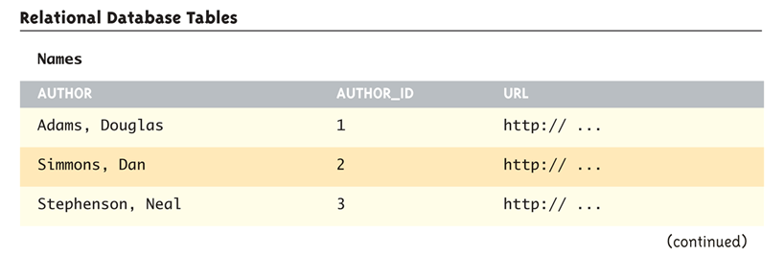
Relational Database Tables (Part 1 of 3)
Copyright © 2010 Pearson Addison-Wesley. All rights reserved.
19-<number>

Slide 49
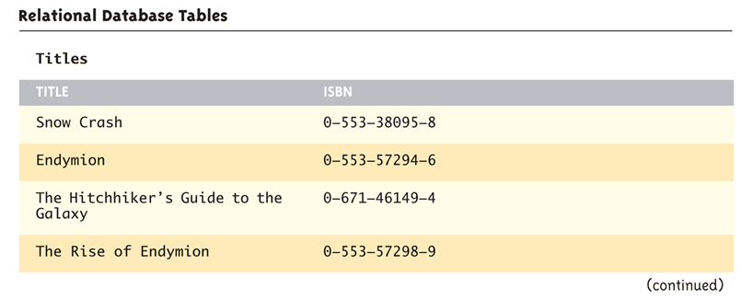
Relational Database Tables (Part 2 of 3)
Copyright © 2010 Pearson Addison-Wesley. All rights reserved.
19-<number>

Slide 50
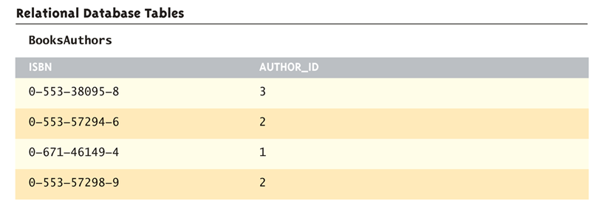
Relational Database Tables (Part 3 of 3)
Copyright © 2010 Pearson Addison-Wesley. All rights reserved.
19-<number>

Slide 51
A Sample SQL Command
The following is a sample SQL command that can be used in conjunction with the tables from the previous slide:
  SELECT Titles.Title, Titles.ISBN, BooksAuthors.Author_ID
  FROM Titles, BooksAuthors
  WHERE Titles.ISBN = BooksAuthors.ISBN
The above command will produce the table shown on the following slide
Copyright © 2010 Pearson Addison-Wesley. All rights reserved.
19-<number>

Slide 52
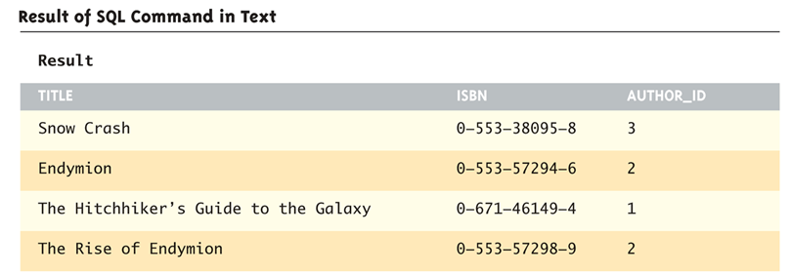
Result of SQL Command in Text
Copyright © 2010 Pearson Addison-Wesley. All rights reserved.
19-<number>

Slide 53
Common SQL Statements (1 of 2)
CREATE TABLE | Create a new table named newtable with fields field1, field2, etc. Data types are similar to Java and include: int, bigint, float, double, and var(size) which is equivalent to a String of maximum length size. | CREATE TABLE newtable (field1 datatype, field2 datatype, ...)
INSERT | Insert a new row into the table tableName where field1 has the value field1Value, field2 has the value field2Value, etc. The data types for the values must match those for the corresponding fields when the table was created. String values should be enclosed in single quotes. | INSERT INTO tableName VALUES (field1Value, field2Value, ...)
Copyright © 2010 Pearson Addison-Wesley. All rights reserved.
19-<number>

Slide 54
Common SQL Statements (2 of 2)
UPDATE | Change the specified fields to the new values for any rows that match the WHERE clause. Op is a comparison operator such as =, <> (not equal to), <, >, etc. | UPDATE tableName SET field1 = newValue, field2 = newValue, ... WHERE fieldName Op someValue
SELECT | Retrieve the specified fields for the rows that match the WHERE clause. The * may be used to retrieve all fields. Omit the WHERE clause to retrieve all rows from the table. | SELECT field1, field2 FROM tableName WHERE fieldname Op someValue
Copyright © 2010 Pearson Addison-Wesley. All rights reserved.
19-<number>

Slide 55
SQL Examples
CREATE TABLE names(author varchar(50), author_id int, url varchar(80))
INSERT INTO names VALUES ('Adams, Douglas', 1, 'http://www.douglasadams.com')
UPDATE names SET url = 'http://www.douglasadams.com/dna/bio.html' WHERE author_id = 1
SELECT author, author_id, url FROM names
SELECT author, author_id, url FROM names WHERE author_id > 1
Copyright © 2010 Pearson Addison-Wesley. All rights reserved.
19-<number>

Slide 56
JDBC
Java Database Connectivity (JDBC) allows SQL commands to be inserted into Java code
  In order to use it, both JDBC and a database system compatible with it must be installed
  A JDBC driver for the database system may need to be downloaded and installed as well
Inside the Java code, a connection to a database system is made, and SQL commands are then executed
Copyright © 2010 Pearson Addison-Wesley. All rights reserved.
19-<number>

Slide 57
Java DB
In the following examples we will use Java DB
  Packaged with version 6 or higher of the Java SDK
  Based on the open source database known as Apache Derby
  See http://developers.sun.com/javadb/
Installation may require some configuration
  See instructions that come with Java DB and more detail in the book
Runs in Network Mode or Embedded Mode
  We only use embedded mode here
Copyright © 2010 Pearson Addison-Wesley. All rights reserved.
19-<number>

Slide 58
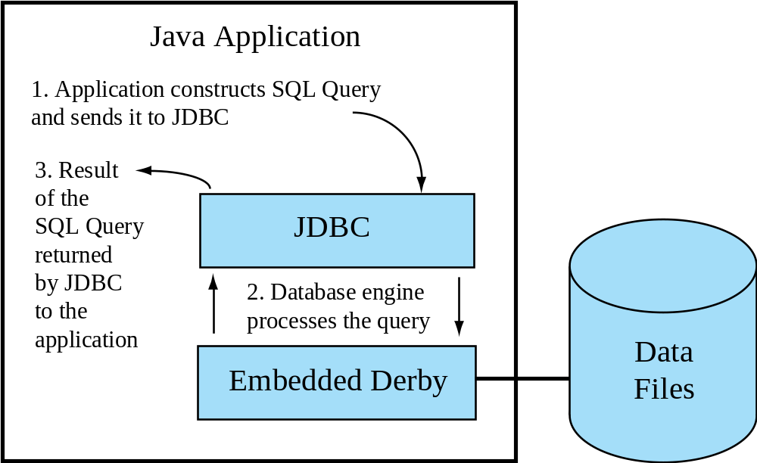
Data Flow of an Embedded Derby Application
Copyright © 2010 Pearson Addison-Wesley. All rights reserved.
19-<number>

Slide 59
Derby Database Connection and Creation
Steps in accessing a Derby database
  Load the driver
  String driver = "org.apache.derby.jdbc.EmbeddedDriver";
  Class.forName(driver).newInstance( );
  Connect to the database using a Connection String
  Connection conn = null;
  conn =
  DriverManager.getConnection("jdbc:derby:BookDatabase;create=true");
  Issue SQL commands to access or manipulate the database
  Statement s = conn.createStatement();
  s.execute(SQLString);
  Close the connection when done
Copyright © 2010 Pearson Addison-Wesley. All rights reserved.
19-<number>

Slide 60
Derby Database Creation Example (1 of 3)
1 import java.sql.Connection;
2 import java.sql.DriverManager;
3 import java.sql.SQLException;
4 import java.sql.Statement;
5 public class CreateDB
6 {
7 private static final String driver = "org.apache.derby.jdbc.EmbeddedDriver";
8 private static final String protocol = "jdbc:derby:";
9 public static void main(String[] args)
10 {
11 try
12 {
13 Class.forName(driver).newInstance();
14 System.out.println("Loaded the embedded driver.");
15 }
16 catch (Exception err)
17 {
18 System.err.println("Unable to load the embedded driver.");
19 err.printStackTrace(System.err);
20 System.exit(0);
21 }
Loads embedded Derby driver
Must catch ClassNotFoundException, InstantiationException, IllegalAccessException.
Copyright © 2010 Pearson Addison-Wesley. All rights reserved.
19-<number>

Slide 61
Derby Database Creation Example (2 of 3)
Connection String to create the database.
Remove “;create=true” if connecting to an
existing database.
22 String dbName = "BookDatabase";
23 Connection conn = null;
24 try
25 {
26 System.out.println("Connecting to and creating the database...");
27 conn = DriverManager.getConnection(protocol + dbName + ";create=true");
28 System.out.println("Database created.");
29 Statement s = conn.createStatement();
30 s.execute("CREATE TABLE names" +
31 "(author varchar(50), author_id int, url varchar(80))");
32 System.out.println("Created 'names' table.");
Create a table called "names" with three fields, 50 characters for an author, an integer author ID, and 80 characters for a URL
Copyright © 2010 Pearson Addison-Wesley. All rights reserved.
19-<number>

Slide 62
Derby Database Creation Example (3 of 3)
Insert sample data
33 System.out.println("Inserting authors.");
34 s.execute("INSERT INTO names " +
35 "VALUES ('Adams, Douglas', 1, 'http://www.douglasadams.com')");
36 s.execute("INSERT INTO names " +
37 "VALUES ('Simmons, Dan', 2, 'http://www.dansimmons.com')");
38 s.execute("INSERT INTO names " +
39 "VALUES ('Stephenson, Neal', 3, 'http://www.nealstephenson.com')");
40 System.out.println("Authors inserted.");
41 conn.close();
42 }
43 catch (SQLException err)
44 {
45 System.err.println("SQL error.");
46 err.printStackTrace(System.err);
47 System.exit(0);
48 }
49 }
50 }
Catch SQL Error Exceptions
SAMPLE DIALOGUE
Loaded the embedded driver.
Connecting to and creating the database.
Database created.
Created 'names' table.
Inserting authors.
Authors inserted.
Copyright © 2010 Pearson Addison-Wesley. All rights reserved.
19-<number>

Slide 63
Retrieving Data from Derby
The SELECT statement is used to retrieve data from the database
  Invoke the executeQuery( ) method of a Statement object.
  Returns an object of type ResultSet that maintains a cursor to each matching row in the database.
    Can iterate through the set with a loop
Copyright © 2010 Pearson Addison-Wesley. All rights reserved.
19-<number>

Slide 64
Processing a ResultSet
Initially, the cursor is positioned before the first row.
The next( ) method advances the cursor to the next row. If there is no next row, then false is returned. Otherwise, true is returned.
Use one of following methods to retrieve data from a specific column in the current row :
intVal = resultSet.getInt("name of int field");
lngVal = resultSet.getLong("name of bigint field");
strVal = resultSet.getString("name of varchar field");
dblVal = resultSet.getDouble("name of double field");
fltVal = resultSet.getFloat("name of float field");
Copyright © 2010 Pearson Addison-Wesley. All rights reserved.
19-<number>

Slide 65
Reading from a Derby Database
SQL to retrieve the ID and
Author for all records
// Code to connect to the database
Statement s = conn.createStatement();
ResultSet rs = null;
rs = s.executeQuery("SELECT author, author_id FROM names");
while (rs.next())
{
int id = rs.getInt("author_id");
String author = rs.getString("author“);
System.out.println(id + " " + author);
}
rs.close();
// Above should be in a try/catch block
Loop through and print all records that match the query
SAMPLE DIALOGUE
1 Adams, Douglas
2 Simmons, Dan
3 Stephenson, Neal
Copyright © 2010 Pearson Addison-Wesley. All rights reserved.
19-<number>

Slide 66
Update Query
Use the execute command for UPDATE queries
Example to change the URL to the contents of the variable newURL for author with ID 1
Statement s = conn.createStatement();
s.execute("UPDATE names SET URL = '" + newURL +
"' WHERE author_id = 1");
Copyright © 2010 Pearson Addison-Wesley. All rights reserved.
19-<number>

Slide 67
More SQL
We have just scratched the surface of what is possible to do with SQL, JDBC, Java DB, etc.
This section covered the basics about how to integrate a database with a Java application
  Refer to database and more advanced Java textbooks to learn more
Copyright © 2010 Pearson Addison-Wesley. All rights reserved.
19-<number>

Slide 68
Web Programming with Java Server Pages
Many technologies exist that allow programs to run within a web browser when visiting a website
Applets
  Run on the client
Servlets
  Compiled Java programs on the server
JSP
  Dynamically compiles to Servlets and integrated with the server
Copyright © 2010 Pearson Addison-Wesley. All rights reserved.
19-<number>

Slide 69
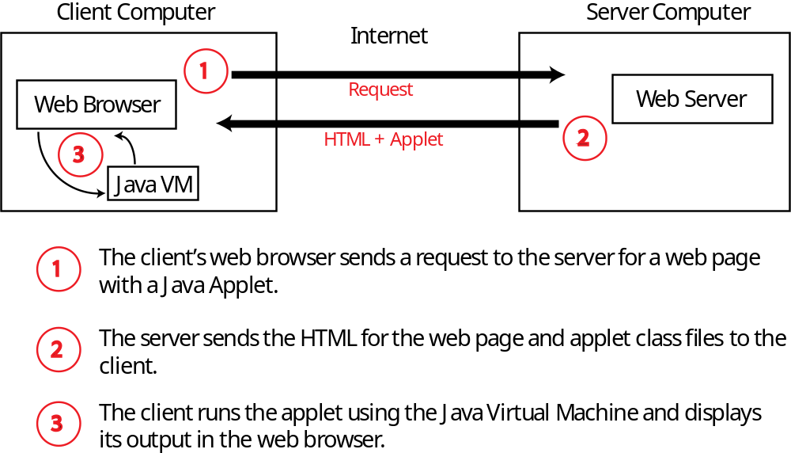
Running a Java Applet
Copyright © 2010 Pearson Addison-Wesley. All rights reserved.
19-<number>

Slide 70
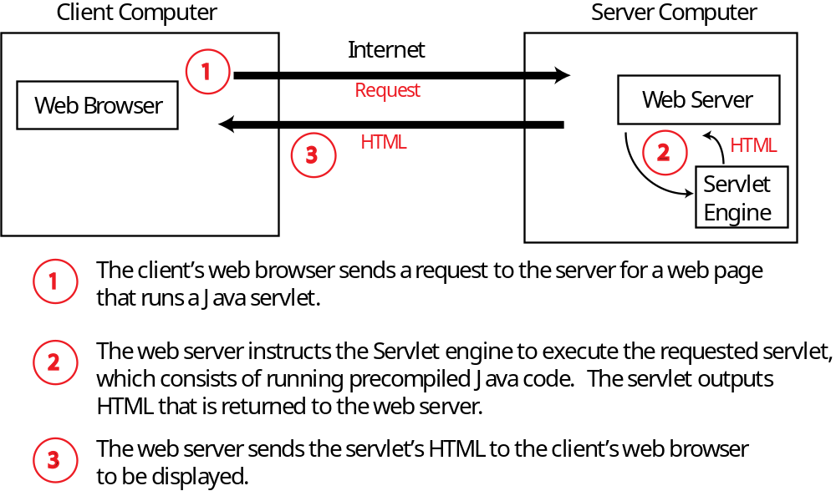
Running a Java Servlet
Copyright © 2010 Pearson Addison-Wesley. All rights reserved.
19-<number>

Slide 71
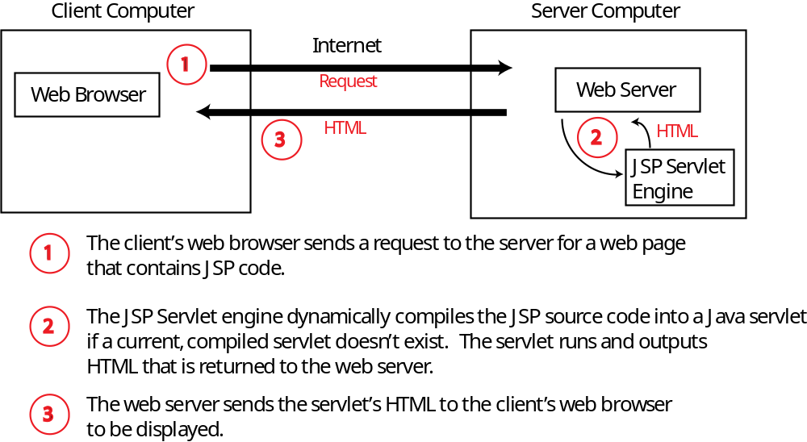
Running a Java Server Page (JSP) Program
Copyright © 2010 Pearson Addison-Wesley. All rights reserved.
19-<number>

Slide 72
JSP Requirements
Web server capable of running JSP servlets
Here we use the Sun GlassFish Enterprise Server, previously known as the Sun Java System Application Server
  Part of the Java Enterprise Edition SDK
  See instructions that come with the software for installation
    Documents go in <glassfish_home>\domains\domain1\docroot
    Default URL is http://localhost:8080
Copyright © 2010 Pearson Addison-Wesley. All rights reserved.
19-<number>

Slide 73
HTML Forms
The information you enter into an HTML form is transmitted to the web server using a protocol called the Common Gateway Interface (CGI)
Syntax for HTML Form
ACTION identifies the program to execute
  In our case, a JSP program
GET or POST identify how data is transmitted
  GET sends data as the URL, POST over the socket
<FORM ACTION="Path_To_CGI_Program" METHOD="GET or POST">
Form_Elements
</FORM>
Copyright © 2010 Pearson Addison-Wesley. All rights reserved.
19-<number>

Slide 74
Some HTML Form Elements
Input Textbox
Submission Button
Many others form elements exist
  E.g. radio buttons, drop down list, etc.
<INPUT TYPE="TEXT" NAME="Textbox_Name" VALUE="Default_Text"
SIZE="Length_In_Characters"
MAXLENGTH="Maximum_Number_Of_Allowable_Characters">
<INPUT TYPE="SUBMIT" NAME="Name" VALUE="Button_Text">
Copyright © 2010 Pearson Addison-Wesley. All rights reserved.
19-<number>

Slide 75
Example HTML Form Document
(Display 19.16)
<html>
<head>
<title>Change Author's URL</title>
</head>
<body>
<h1>Change Author's URL</h1>
<p>
Enter the ID of the author you would like to change
along with the new URL.
</p>
<form ACTION = "EditURL.jsp" METHOD = POST>
Author ID:
<input TYPE = "TEXT" NAME = "AuthorID"
VALUE = "" SIZE = "4" MAXLENGTH = "4">
<br />
New URL:
<input TYPE = "TEXT" NAME = "URL"
VALUE = "http://" SIZE = "40" MAXLENGTH = "200">
<p>
<INPUT TYPE="SUBMIT" VALUE="Submit">
</p>
</form>
</body>
</html>
Invokes the JSP program named EditURL.jsp. If this program does not exist you will see an error message upon clicking the Submit button.
Creates a TextBox named AuthorID that is empty, displays 4 characters at once, and accepts at most 4 characters.
Creates a submission button
Copyright © 2010 Pearson Addison-Wesley. All rights reserved.
19-<number>

Slide 76
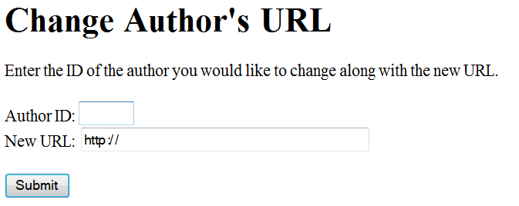
Browser View of HTML Form Document
Copyright © 2010 Pearson Addison-Wesley. All rights reserved.
19-<number>

Slide 77
JSP Tags - Declarations
Declarations
  Use to define variables and methods
  The variables and methods are accessible from any scriptlets and expressions on the same page
  Variable declarations are compiled as instance variables for a class that corresponds to the JSP page
  Syntax:
  <%!
  Declarations
  %>
<%!
private int count = 0;
private void incrementCount()
{
count++;
}
%>
Defines an instance variable named count and a method named incrementCount that increments the count variable
Copyright © 2010 Pearson Addison-Wesley. All rights reserved.
19-<number>

Slide 78
JSP Tags - Expressions
Expressions
  Use to access variables defined in declarations
  Syntax:
  <%=
  Expression
  %>
The value of count is <b> <%= count %> </b>
Outputs the value of the count variable in bold type
Copyright © 2010 Pearson Addison-Wesley. All rights reserved.
19-<number>

Slide 79
JSP Tags - Scriptlet
Scriptlet
  Use to embed blocks of Java Code
  Syntax:
  <%
  Java Code
  %>
  Use out.println() to output to the browser
<%
incrementCount();
out.println("The counter's value is " + count + "<br />");
%>
Invokes the incrementCount( ) method and then outputs the value in count
Copyright © 2010 Pearson Addison-Wesley. All rights reserved.
19-<number>

Slide 80
JSP Example To Display Heading Levels
<html>
<title>
Displaying Heading Tags with JSP
</title>
<body>
<%!
private static final int LASTLEVEL = 6;
%>
<p>
This page uses JSP to display Heading Tags from
Level 1 to Level <%= LASTLEVEL %>
</p>
<%
int i;
for (i = 1; i <= LASTLEVEL; i++)
{
out.println("<H" + i + ">" +
"This text is in Heading Level " + i +
"</H" + i + ">");
}
%>
</body>
</html>
JSP Declaration
JSP Expression that evaluates to 6
JSP Scriptlet
Copyright © 2010 Pearson Addison-Wesley. All rights reserved.
19-<number>

Slide 81
HTML Generated by JSP Example
<html>
<title>
Displaying Heading Tags with JSP
</title>
<body>
<p>
This page uses JSP to display Heading Tags from
Level 1 to Level 6
</p>
<H1>This text is in Heading Level 1</H1>
<H2>This text is in Heading Level 2</H2>
<H3>This text is in Heading Level 3</H3>
<H4>This text is in Heading Level 4</H4>
<H5>This text is in Heading Level 5</H5>
<H6>This text is in Heading Level 6</H6>
</body>
</html>
Copyright © 2010 Pearson Addison-Wesley. All rights reserved.
19-<number>

Slide 82
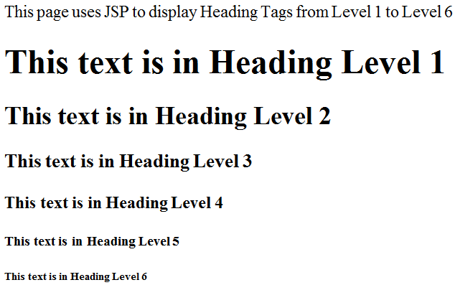
Browser View of JSP Page
Copyright © 2010 Pearson Addison-Wesley. All rights reserved.
19-<number>

Slide 83
Reading HTML Form Input
The request.getParameter method takes a String parameter as input that identifies the name of an HTML form element and returns the value entered by the user for that element on the form.
  For example, if there is a textbox named AuthorID then we can retrieve the value entered in that textbox with the scriptlet code:
String value = request.getParameter("AuthorID");
If the user leaves the field blank then getParameter returns an empty string.
Copyright © 2010 Pearson Addison-Wesley. All rights reserved.
19-<number>

Slide 84
JSP Program To Echo Input From the HTML Form in Display 19.16
This file should be named “EditURL.JSP” and match the entry in the ACTION tag of the HTML form.
<html>
<title>Edit URL: Echo submitted values</title>
<body>
<h2>Edit URL</h2>
<p>
This version of EditURL.jsp simply echoes back to the
user the values that were entered in the textboxes.
</p>
<%
String url = request.getParameter("URL");
String stringID = request.getParameter("AuthorID");
int author_id = Integer.parseInt(stringID);
out.println("The submitted author ID is: " + author_id);
out.println("<br/>");
out.println("The submitted URL is: " + url);
%>
</body>
</html>
The getParameter method calls return as Strings the values entered by the user in the URL and AuthorID textboxes from Display 19.16.
Copyright © 2010 Pearson Addison-Wesley. All rights reserved.
19-<number>

Slide 85
Sample Dialogue for EditUrl.JSP
SUBMITTED ON THE WEB BROWSER WHEN VIEWING DISPLAY 19.16
Author ID:
2
New URL:
http://www.dansimmons.com/about/bio.htm
WEB BROWSER DISPLAY AFTER CLICKING SUBMIT
Edit URL
This version of EditURL.jsp simply echoes back to the user the values that were entered in the textboxes.
The submitted author ID is: 2
The submitted URL is: http://www.dansimmons.com/about/bio.htm
Copyright © 2010 Pearson Addison-Wesley. All rights reserved.
19-<number>

Slide 86
JSP Tags - Directive
Directives
  Instruct the compiler how to process a JSP program. Examples include the definition of our own tags, including the source code of other files, and importing packages.
  Syntax:
  <%@
  Directives
  %>
<%@
page import="java.util.*,java.sql.*"
%>
Import libraries so we could use SQL code. Multiple packages separated by a comma.
Copyright © 2010 Pearson Addison-Wesley. All rights reserved.
19-<number>

Slide 87
More JSP
Although we have covered enough JSP to write fairly sophisticated programs, there is much more that we have not covered.
  For example, beans can be used as a convenient way to encapsulate data submitted from a HTML form.
  Sessions, tag libraries, security, and numerous other topics are important in the construction of JSP pages.
  Refer to a textbook dedicated to JSP to learn more.
Copyright © 2010 Pearson Addison-Wesley. All rights reserved.
19-<number>

